Slide 1
Dungeons
Dragons
An Adventure into Spells
Tatum Good & Kendall Leonard
&
&

Slide 2
So… What is it?
Fantasy tabletop role-playing game published in 1974
Two roles, the Game Master (GM) and the Player
Players create characters and the GM serves as referee and storyteller for the game

Slide 3
Character Building
Non-Casters
Spell-Casters
Examples
Examples
Classes that don’t cast spells and focus more on punching the bad guys themselves!
Characters that use some sort of magic, some more than others!
Fighter, Monk, Barbarian, Rogue, Gunslinger etc.
Wizard, Sorcerer, Warlock, Cleric, Druid, Ranger, Paladin, etc.

Slide 4

The Website
Scraped 524 Spells
This site contains all “official” material, but there are thousands more that are fanmade (and of better quality!)
Chose it because it has organized mini-sites for each spell, making the project easier

Slide 5
The Goal
Create a database that Players and GM’s alike can use that takes less time to access than the traditional website. Also create something that allows analysis to be performed on spells, giving valuable insight into the game mechanics.

Slide 6
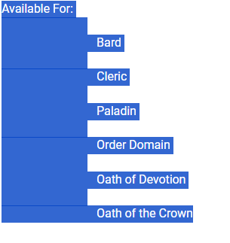
Cleaning the Data
A journey!
Had to drop some inaccessible spells (524 to 517)
Fix some strange spacing
Normalization

Slide 7
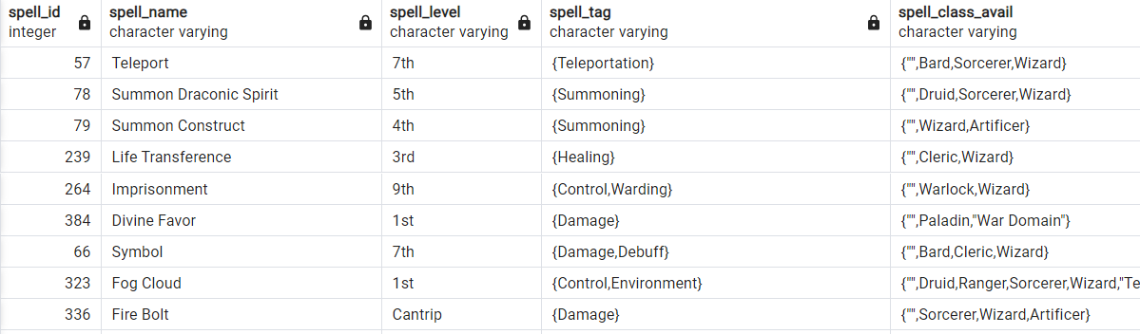
Oh look at the view!
A Quick Spell Overview:
Useful for mid-game look up
Gives the name, spell level, spell tag and classes it’s available for

Slide 8

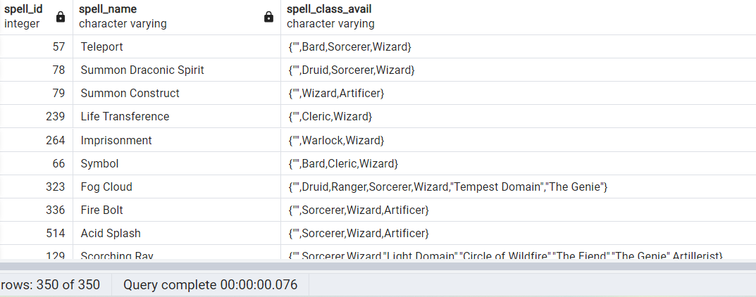
A Class Example
This is you!
Another View
You need spells, but you don’t know what you can learn. Don’t worry, we got you covered!

Slide 9
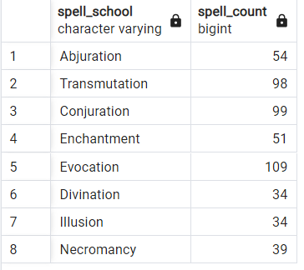








School is in Session
A notable aspect of spells are their schools! Gives a broader overview of what the spell does!

Slide 10

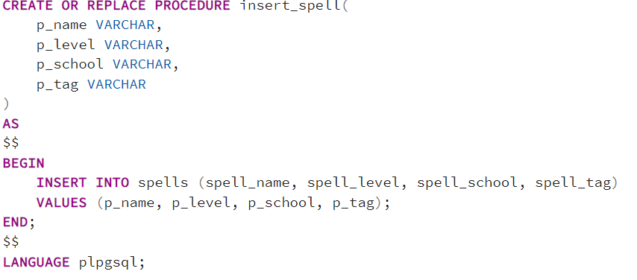
But what if…
We wanted to add in some new spells?
We have a procedure for that

Slide 11
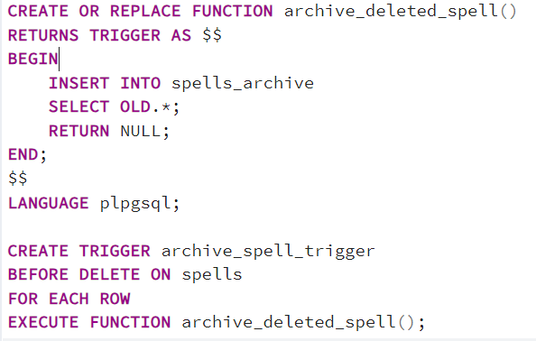
Oh no!
With a large fanbase, A LOT of spells are made, and not all of them are good. Say we accidentally added in a bad spell, we don’t want to delete it, since it's a good example of what not to do.

Slide 12
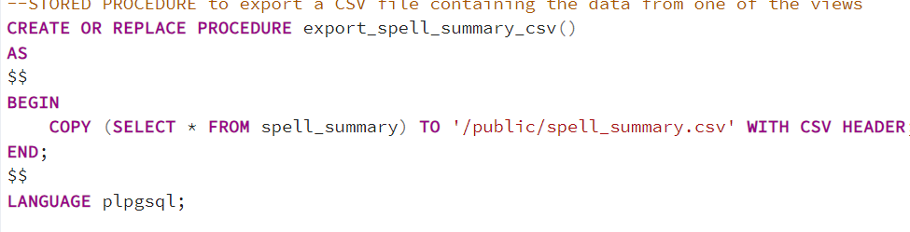
I want to keep this…..
So, we made a way to keep it so even if you aren’t able to access the full database, you can still find your spells

Slide 13
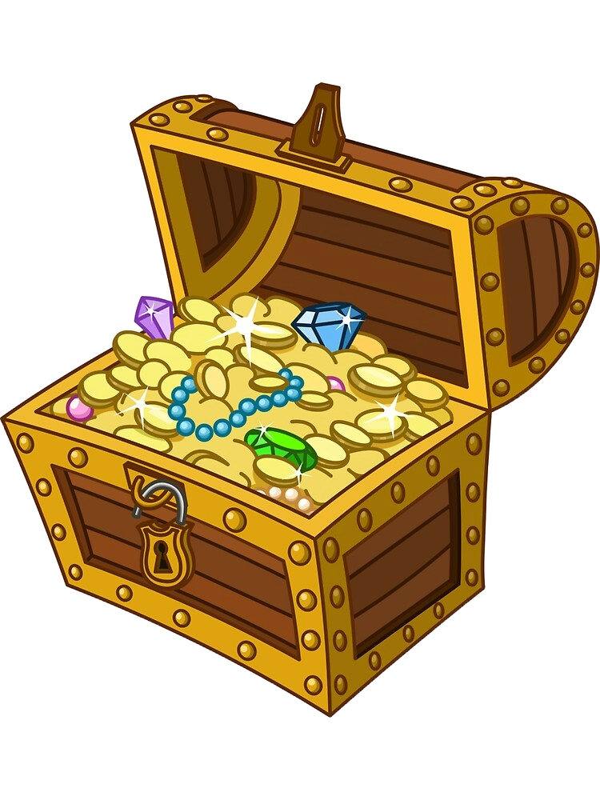
Future Work
Add in more spells from more sites!
Branch out into equipment and player features
Add in permissions, like GM or player
Perhaps implement to other TTRPGS!

Slide 14
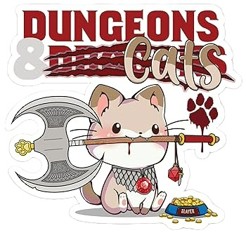
Thank you!
Any questions?

